Slide 1
Introduction to ATMEGA

Slide 2
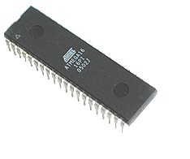
What is a Microcontroller
Microcontroller can be termed as a single on chip computer which includes number of peripherals like RAM, EEPROM, Timers etc., required to perform some predefined task.

Slide 3
Obvious Question
Does this mean that the microcontroller is another name for a computer???
The answer is NO!
The computer designed to perform all the general purpose tasks on a single machine like run a software, store some multimedia file or to access internet
Microcontrollers are meant to perform only the specific tasks, for e.g., switching the AC off automatically

Slide 4
Different ‘famlies’
There are number of popular families of microcontrollers which are used in different applications as per their capability and feasibility to perform the desired task.
Most common of these are 8051, AVR and PIC microcontrollers.

Slide 5
What is ATMega
ATMega is a microcontroller developed by the company ATMEL
It falls in the AVR(Advanced Virtual RISC) series of microcontrollers

Slide 6
AVR microcontrollers are available in three categories:
TinyAVR – Less memory, small size, suitable only for simpler applications
MegaAVR – These are the most popular ones having good amount of memory (upto 256 KB), higher number of inbuilt peripherals and suitable for moderate to complex applications.
XmegaAVR – Used commercially for complex applications, which require large program memory and high speed.

Slide 7
Some Features of ATMega 16
Some of the features of Atmega16 are:
16KB of Flash memory
512 Bytes of EEPROM
Available in 40-Pin DIP
8-Channel 10-bit ADC
Two 8-bit Timers/Counters
One 16-bit Timer/Counter
4 PWM Channels
In System Programmer (ISP)
Serial USART
SPI Interface
Digital to Analog Comparator.

Slide 8
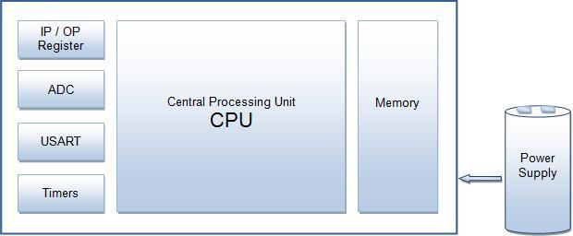
ATMega Architecture

Slide 9
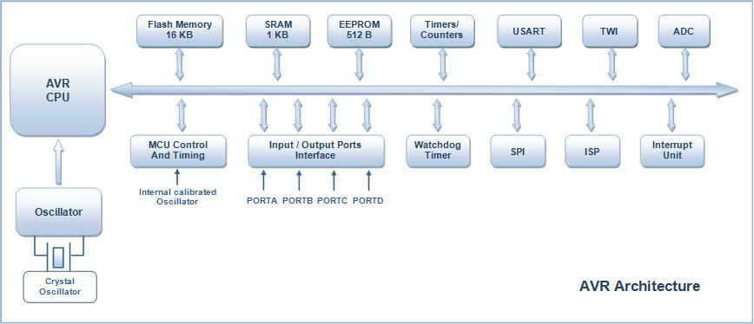
ATMega 16 Architecture

Slide 10
I/O Ports:
Atmega16 has four (PORTA, PORTB, PORTC and PORTD) 8-bit input-output ports.
Internal Calibrated Oscillator:
Atmega16 is equipped with an internal oscillator for driving its clock. By default Atmega16 is set to operate at internal calibrated oscillator of 1 MHz.
Alternatively, ATmega16 can be operated using an external crystal oscillator with a maximum frequency of 16MHz.

Slide 11
ADC Interface:
Atmega16 is equipped with an 8 channel ADC (Analog to Digital Converter) with a resolution of 10-bits.
ADC reads the analog input for e.g., a sensor input and converts it into digital information which is understandable by the microcontroller.
Timers/Counters:
Atmega16 consists of two 8-bit and one 16-bit timer/counter.
Timers are useful for generating precision actions for e.g., creating time delays between two operations.

Slide 12
Interrupts:
Atmega16 consists of 21 interrupt sources out of which four are external. The remaining are internal interrupts which support the peripherals like USART, ADC, Timers etc.
USART:
Universal Synchronous and Asynchronous Receiver and Transmitter interface is available for interfacing with external device capable of communicating serially (data transmission bit by bit).

Slide 13
Memory: Atmega16 consist of three different memory sections:
Flash EEPROM: Flash EEPROM or simple flash memory is used to store the program dumped or burnt by the user on to the microcontroller. It can be easily erased electrically as a single unit. Flash memory is non-volatile i.e., it retains the program even if the power is cut-off. Atmega16 is available with 16KB of in system programmable Flash EEPROM.

Slide 14
Byte Addressable EEPROM:
This is also a nonvolatile memory used to store data like values of certain variables. Atmega16 has 512 bytes of EEPROM, this memory can be useful for storing the lock code if we are designing an application like electronic door lock.
SRAM:
Static Random Access Memory, this is the volatile memory of microcontroller i.e., data is lost as soon as power is turned off. Atmega16 is equipped with 1KB of internal SRAM. A small portion of SRAM is set aside for general purpose registers used by CPU and some for the peripheral subsystems of the microcontroller.

Slide 15
ISP:
AVR family of controllers have In System Programmable Flash Memory which can be programmed without removing the IC from the circuit, ISP allows to reprogram the controller while it is in the application circuit.
SPI:
Serial Peripheral Interface, SPI port is used for serial communication between two devices on a common clock source. The data transmission rate of SPI is more than that of USART.

Slide 16
TWI:
Two Wire Interface (TWI) can be used to set up a network of devices, many devices can be connected over TWI interface forming a network, the devices can simultaneously transmit and receive and have their own unique address.
DAC:
Atmega16 is also equipped with a Digital to Analog Converter (DAC) interface which can be used for reverse action performed by ADC. DAC can be used when there is a need of converting a digital signal to analog signal.

Slide 17
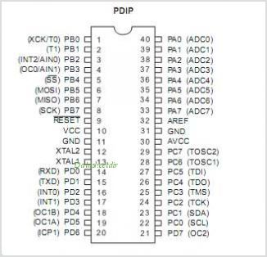
ATMega 16 Pin Diagram

